Slide 1
Counterfactual Explanations for Group Recommendations Part 4
Dilrukshi Keerthirathna
Kalpana Randeniya

Slide 2
Why do groups need counterfactual explanations?
Counterfactual explanations show how specific movie ratings by users affect the group recommendations.
Importance for group recommendations:
Ensures fairness : avoids giving one user’s ratings too much influence over group suggestions.
Highlights influential movies : identifies which movies in the dataset caused specific recommendations for the whole group.
Supports transparency: group members understand why certain movies appear in their recommendations.

Slide 3
Example Explanation
Scenario
Group of users: [User 1, User 2, User 3, User 4, User 5].
Top recommended item: Movie A.
Explanation
"If the group had not interacted with {Movie B, Movie C}, then Movie A would not have been suggested.“
Fairness Highlight
Items {Movie B, Movie C} are selected because they were interacted with by multiple users.

Slide 4
Methodology for Generating Group-Based Counterfactuals
Identify Group Preferences : Compute the average rating of each item across all group members.
Determine Top Recommendations : Select the top-10 items for the group based on average scores.
Simulate Alternative Scenarios : Systematically remove combinations of previously interacted items from the user-item matrix.
Counterfactual Explanations: Observe how recommendations change when specific subsets of interacted items are removed.

Slide 5
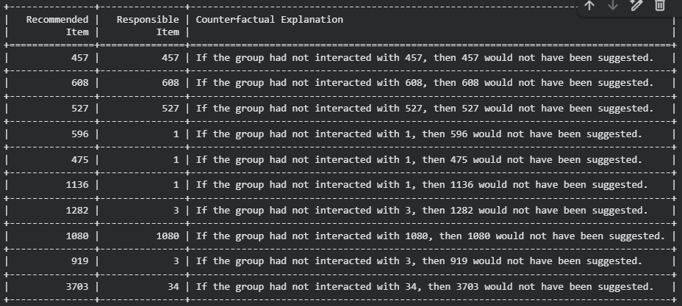
Implementation output

Slide 6
Thank You

